Slide 1

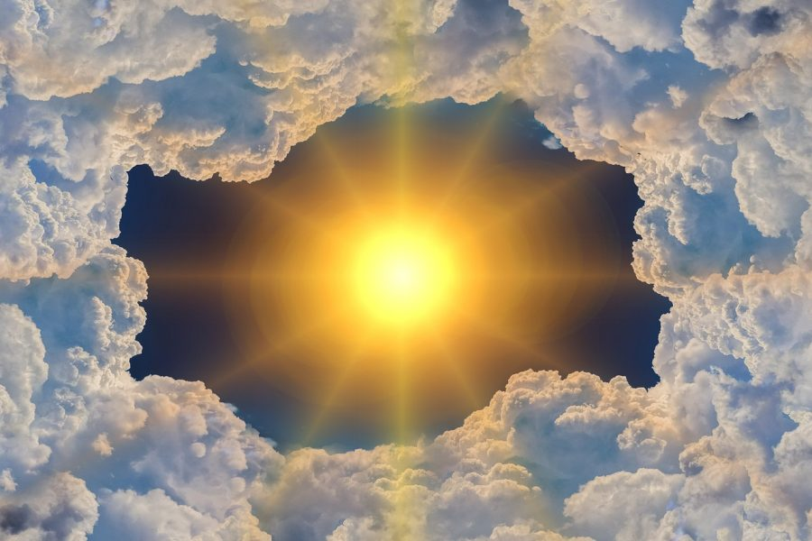
Specific Heat Capacity Year 11 ATAR Physis
Mrs Martin
This Photo by Unknown Author is licensed under CC BY-ND

Slide 2



Do not delete this slide. It is hidden from your show. You can use it to copy and paste the relevant prompt boxes into your presentation. Click once on the white space to select it for copying. Once it is in your presentation you can double click on the white space to add text. The box will automatically resize to fit your text. The next slide is also hidden and included as an example only.
Make the Connection
Check for Understanding
Teacher Cue
Vocabulary
Extension
Hints

Slide 4
What is sound?
Notes:
Sound is a longitudinal wave of vibrating particles (back and forth)

Slide 5
What is sound?
CFU

Slide 6
Question
Hint

Slide 8
What is the absolute temperature scale?
Which of the following converts to degrees?
_________ + 273.15 = _________
_________ - 273.15 = _________

Slide 9
Definitions from previous lesson
Thermal energy – the total kinetic and potential energy in a substance
Temperature – measure of the average kinetic energy of the particles in a substance
Heat – transfer of thermal energy from one substance to another due to a difference in temperatures
Thermal equilibrium – when two objects have the same temperature
Notes:
Sound is a longitudinal wave of vibrating particles (back and forth)

Slide 11
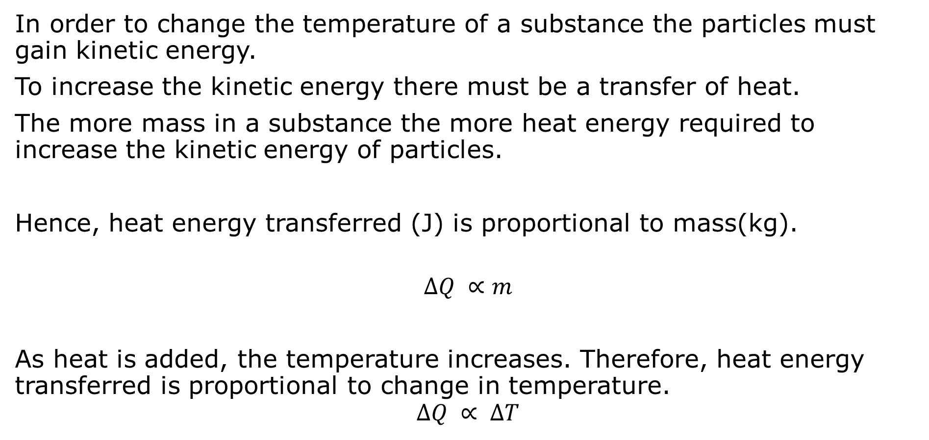
Changing Temperature
In order to change the temperature of a substance the particles must gain kinetic energy.
To increase the kinetic energy there must be a transfer of heat.
The more mass in a substance the more heat energy required to increase the kinetic energy of particles.
Hence, heat energy transferred (J) is proportional to mass(kg).
$$∆Q ∝m$$
As heat is added, the temperature increases. Therefore, heat energy transferred is proportional to change in temperature.
$$∆Q ∝ ∆T$$
Notes:
Teacher Cue – refer to the vocabulary box as you read through and “unpack” the definition provided. Use hand gestures to emphasise the ”2 or more”, “mixed” and “separated” parts of the definition.
Have students complete CFU 1 as a pair-share, then record these definitions & examples as notes (with diagrams) if desired.
CFU 2 – pair-share, then whiteboards for answers – call on non-volunteers.

Slide 12
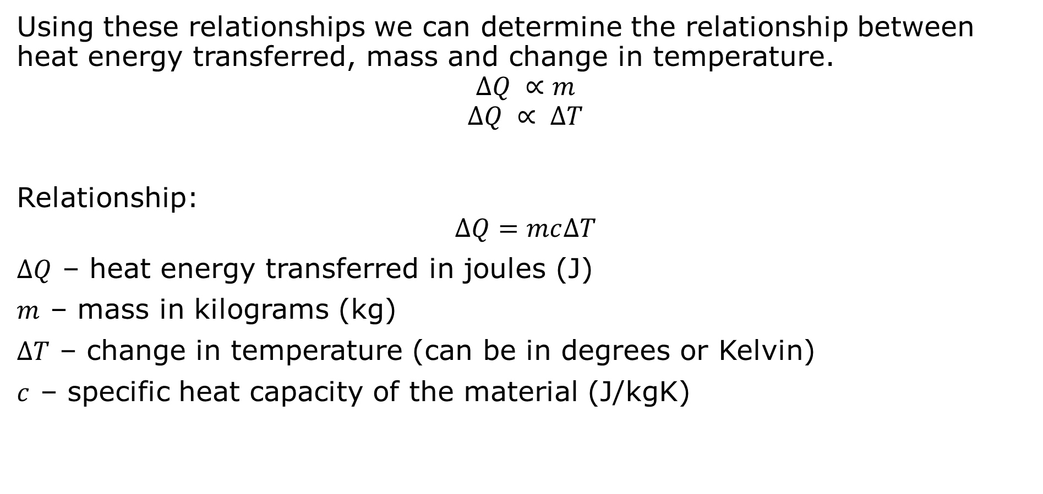
Specific Heat Capacity
Using these relationships we can determine the relationship between heat energy transferred, mass and change in temperature.
$$∆Q ∝m$$
$$∆Q ∝ ∆T$$
Relationship:
$$∆Q=mc∆T$$
$∆Q$ – heat energy transferred in joules (J)
$m$ – mass in kilograms (kg)
$∆T$ – change in temperature (can be in degrees or Kelvin)
$c$ – specific heat capacity of the material (J/kgK)
Notes:
Teacher Cue – refer to the vocabulary box as you read through and “unpack” the definition provided. Use hand gestures to emphasise the ”2 or more”, “mixed” and “separated” parts of the definition.
Have students complete CFU 1 as a pair-share, then record these definitions & examples as notes (with diagrams) if desired.
CFU 2 – pair-share, then whiteboards for answers – call on non-volunteers.

Slide 13

Specific Heat Capacity
$c$ – specific heat capacity of the material (J/kgK)
The specific heat capacity is different for different materials.
Rearranging the specific heat equation for c=:
$$∆Q=mc∆T$$
$$\frac{∆Q}{m}=c∆T$$
$$c=\frac{∆Q}{m∆T }$$
$$c=\frac{J}{kg ×K }$$
Replace the symbols in the equations with the units.
This will determine the units that specific heat capacity have.
Notes:
Teacher Cue – refer to the vocabulary box as you read through and “unpack” the definition provided. Use hand gestures to emphasise the ”2 or more”, “mixed” and “separated” parts of the definition.
Have students complete CFU 1 as a pair-share, then record these definitions & examples as notes (with diagrams) if desired.
CFU 2 – pair-share, then whiteboards for answers – call on non-volunteers.

Slide 14
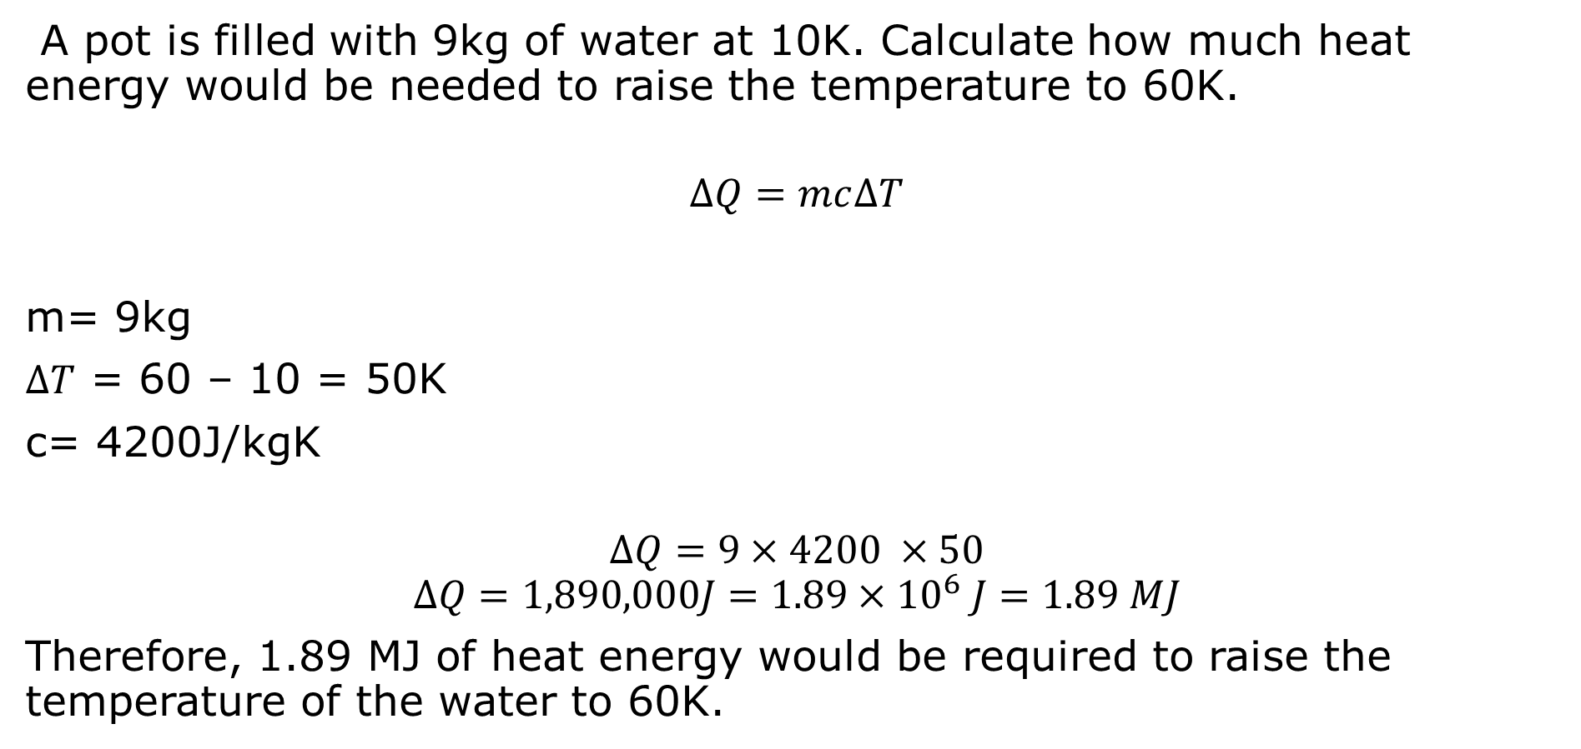
Example 1
A pot is filled with 9kg of water at 10K. Calculate how much heat energy would be needed to raise the temperature to 60K.
$$∆Q=mc∆T$$
m= 9kg
$∆T$ = 60 – 10 = 50K
c= 4200J/kgK
$$∆Q=9×4200 ×50$$
$$∆Q=1,890,000J=1.89×{10}^{6} J=1.89 MJ$$
Therefore, 1.89 MJ of heat energy would be required to raise the temperature of the water to 60K.
Notes:
Teacher Cue – refer to the vocabulary box as you read through and “unpack” the definition provided. Use hand gestures to emphasise the ”2 or more”, “mixed” and “separated” parts of the definition.
Have students complete CFU 1 as a pair-share, then record these definitions & examples as notes (with diagrams) if desired.
CFU 2 – pair-share, then whiteboards for answers – call on non-volunteers.

